Slide 1


Arranging an Audio Track to other Genre using CycleGAN-based Deep Learning
Alex DongHyeon Seo
Hyecheol (Jerry) Jang
Stella Kim

Slide 2
Table of contents
Introduction / Motivation
Objective / Related Work
Method
Experiments
Results
Discussion / Conclusion

Slide 3
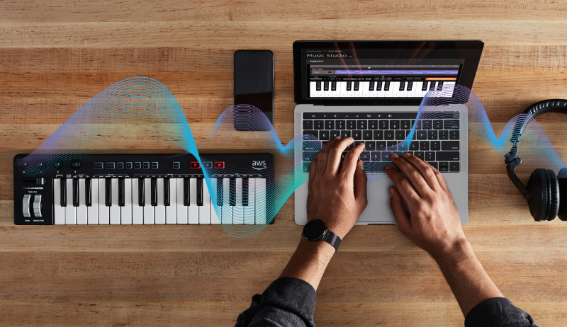
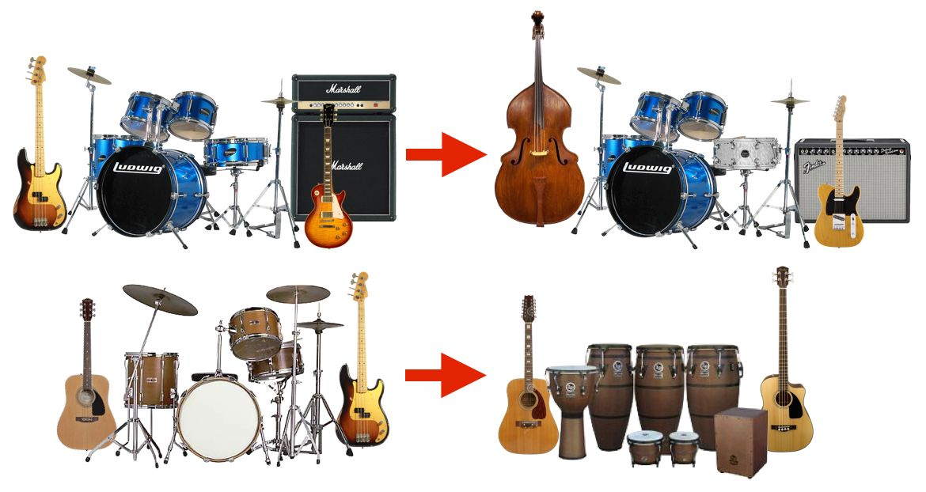
Introduction / Motivation
AWS Deep composer applies Deep Generative models to help users build their own creative music just with the keyboard notes they provide
<AWS Deep Composer>
There are a lot of trials to arrange specific songs to different genre to provide listeners to have new musical experience
<Music Arrangement to Different Genre>

Slide 4
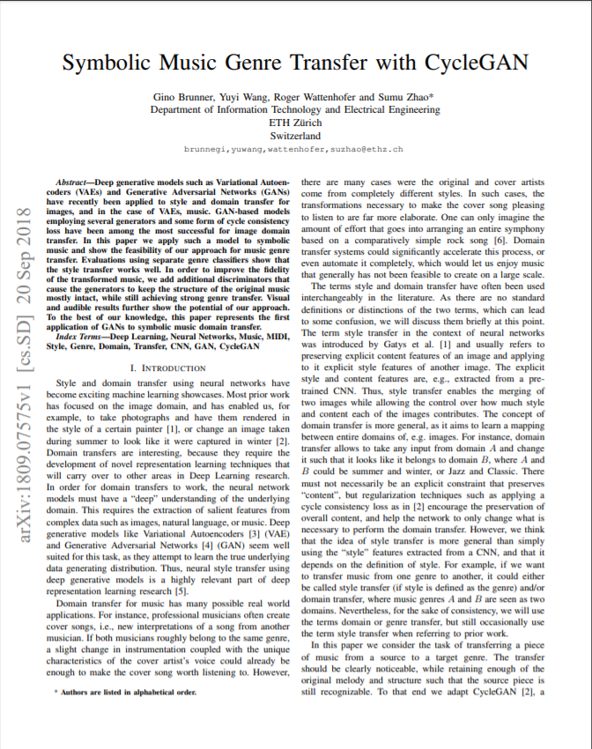
Objective / Related Work
- Project Objective
Change the genre of a music track, given a set of user input containing song and desired genre
Use CycleGAN–based model that is widely used in image-to-image translation and use MIDI file as an input data
- Related Work (Brunner et al.)
Motivated from great success of using Deep Generative Models for style transfer for images, this paper approaches to apply generative models to transfer music style
<Referenced CycleGAN-based model paper>
However, they used MIDI file with complicated data pre-processing work that would generate biased results

Slide 5
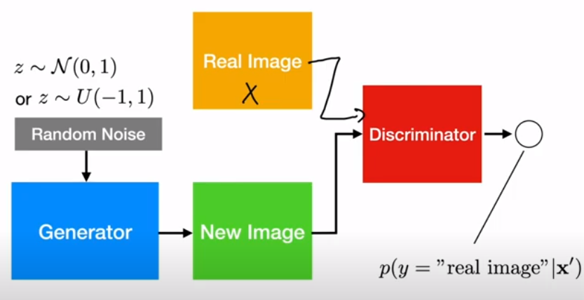
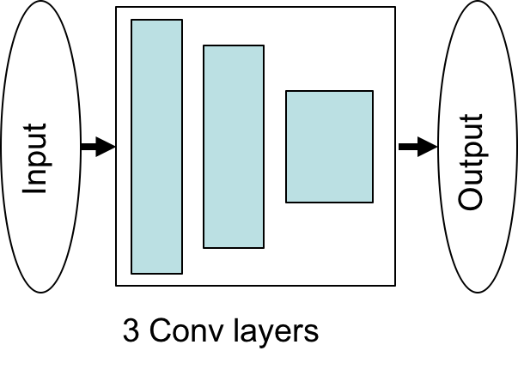
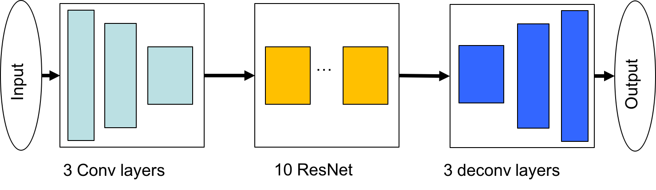
Method
General GAN model consists of Generating Model and Discriminating Model
Generator’s goal is to fool discriminator by making a good fake output which looks like a real one
Discriminator’s goal is to check whether the given output is fake(generated by model) or real(from label)
<Generator for our model>
<Discriminator for our model>

Slide 6
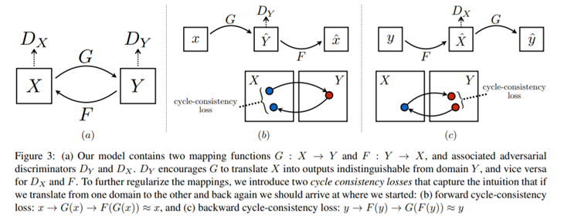
Method
- CycleGAN
CycleGAN consists of two GANs arranged in cyclic fashion and trains in unison
Model checks the quality of transfer by using both XtoY and YtoX translator.
Once we transfer from X to Y, we use YtoX translator to restore original x, then calculate the difference
Dx, Dy : Discriminator
G, F : Generator

Slide 7
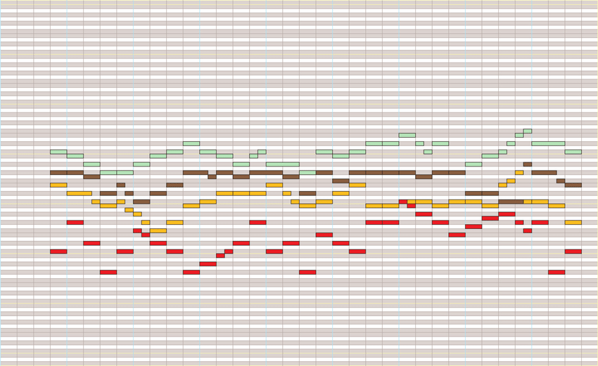
Experiments – Data Selection
<Data Experiment>
Raw Audio File (MP3, WAV): Could not find anyway to put these files to the Machine Learning models
Convert Audio File to MIDI: Audio files have independent audio from multiple instruments and computer could not isolate each instruments
Raw MIDI file: MIDI is a standardized way to represent the musical instruments via computer
<Example of MIDI file>
MIDI: Electrical version of musical sheet
Decided to use MIDI file for our dataset

Slide 8
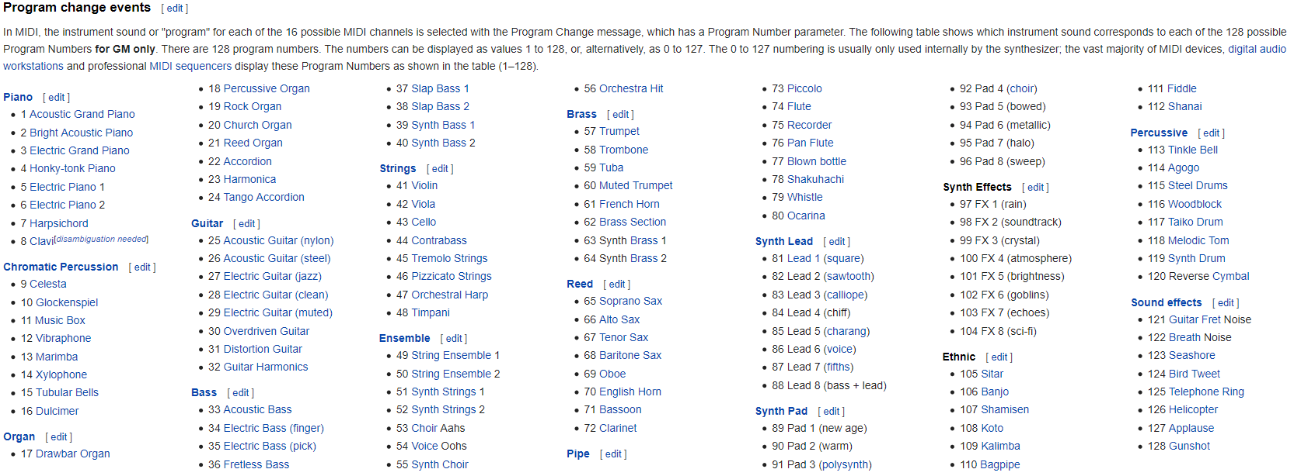
Experiments – Data Selection
Advantage of using MIDI file is that MIDI specifies the different instruments independently
There are 128 representations of different instruments

Slide 9
Experiments – Code Analysis
<Benchmarking Study>
Brunner et al. paper’s code were reviewed – Uses TensorFlow 1.4 https://github.com/sumuzhao/CycleGAN-Music-Style-Transfer
Problems
Solutions
Fixed to use latest version of
TF 1.x
Fixed the code to iterate all defined dataset at once while pre-processing
Fixed to use command line argument while training and testing the model
Uses outdated version of TF
Some functions that were used in this code were removed from TF
Most of the codes contained hard-coded directory connection
Unnecessary data preprocessing produced biased result

Slide 10
Experiments – Generalized Model
The Brunner et al.’s model filtered MIDI file such that 1. Having time signature change 2. First beat does not start at time 0 3. Time signature is not 4/4
The music that does not filter is very specific, which does not represent the songs in the genre
Our goal for here is to remove those filters and make generalized model based on the Brunner et al.’s work.

Slide 11

Results – Generalized Model
Original Song does not contain all sounds as the code only uses one track (the piano), and drop the others (Only accept 2D array[tone, time] for training)
Input data does not represent all the sounds of a song
Causing the model unable to learn the characteristic of each genre
<Original Pop Song>
<Transferred to Classical>
<Original Classical>
<Transferred to Pop Song>

Slide 12
Experiments – Merged to one Channel
Seeing the Results and the analysis for generalized model trial,
We at least need to merge tracks to solve dimension issue or need to fix code to utilize 3D tensor for input
There exists blank slices
Remove trailing and ending whitespace from the MIDI file before slicing
Model 1: epoch = 100, Learning Rate = 0.0002, ngf = 64
Model 2: epoch = 200, Learning Rate = 0.0001, ngf = 64
Model 3: epoch = 100, Learning Rate = 0.0002, ngf = 128
Model 4: epoch = 200, Learning Rate = 0.0001, ngf = 128
Note that learning rate linearly diminish after 50% of epoch

Slide 13
Result – Merged to one Channel
At least it sounds like a song
It also contains the melody from
the original track
But hard to tell if the transferred song belongs to classical or pop
Need further verification on the reason why
Maybe because lots of pop songs are already motivated from classical songs
By removing the instrument information, it ruins the characteristics of each genre
For further studies, Try with other genres: Jazz and Rock
<Original Pop Song>
<Model 1>
<Model 2>
<Transferred to Classical>
<Original Classical>
<Model 1>
<Model 2>
<Transferred to Pop>

Slide 14
Discussion / Conclusion
There is no perfect way to pass full audio information to deep learning model. Using MIDI file is not generalized approach to represent music. (We do not commonly use MIDI files to listen to the music)
While the ResNet and U-Net are reckoned to be the state-of-the-arts convolution filters for vision tasks, there’s no “good” convolution filters for audio tasks to the best of our knowledge
Using Spectrogram is another way to deal with audio tasks, but it can only be used for classification as there is no way to map spectrogram back to the audio.
Further Topics Modify the model structure to get 3D tensor as input to represent all the instruments. Try with other genres

Slide 15
References
Brunner, G., Wang, Y., Wattenhofer, R., & Zhao, S. (2018, September 20). Symbolic Music Genre Transfer with CycleGAN. Retrieved from https://arxiv.org/abs/1809.07575
Zhu, J.-Y., Park, T., Isola, P., & Efros, A. A. (2018, November 15). Unpaired Image-to-Image Translation using Cycle-Consistent Adversarial Networks. Retrieved from https://arxiv.org/abs/1703.10593
https://www.midi.org/specifications-old/item/gm-level-1-sound-set

Slide 16


Thank You!

